Slide 1
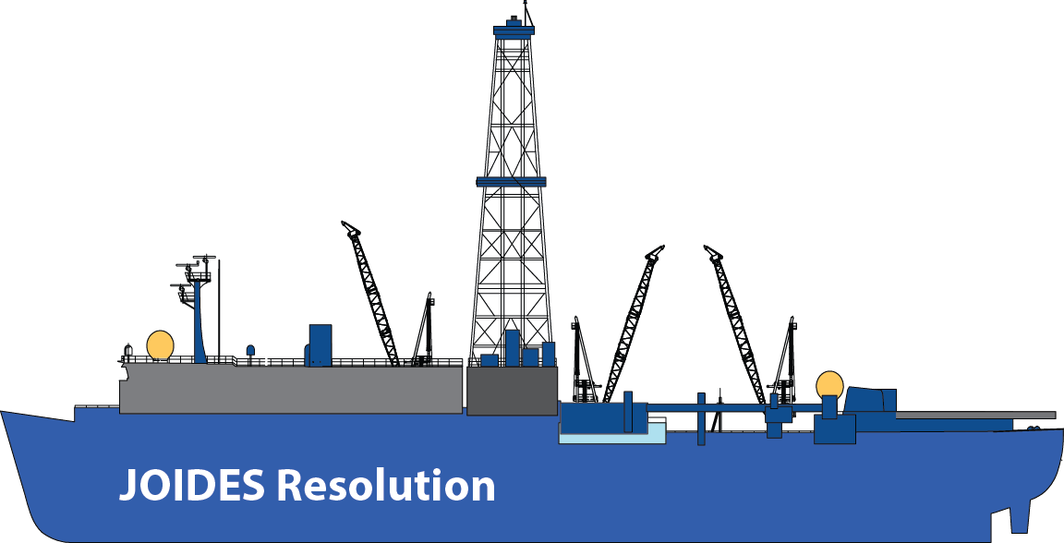
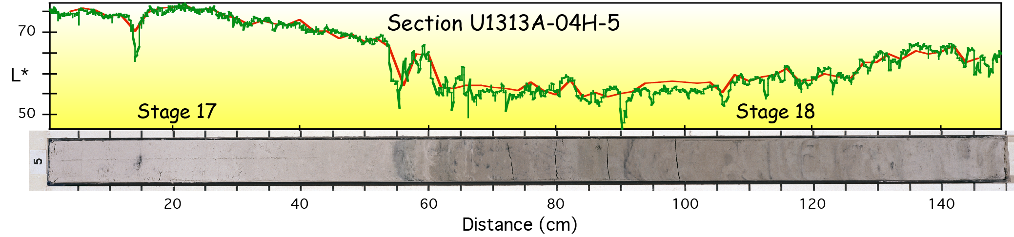
Data Mining Applied to the IODP Database
19 June 2019

Slide 2
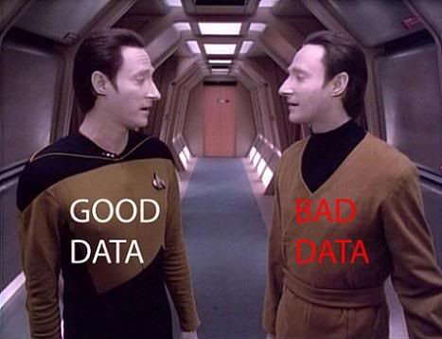
Goals
Brainstorm about Data Mining Projects
Convey what each of us are doing
Present ideas for Data Mining Projects
Discuss ways to improve the database and/or the availability of database tools in order to make data mining more accessible and impactful
Add lithologies to any data with an IODP interval
Relate different data types by interpolation to nearest neighbor
Extract color space values from images
Improved correlation tools
Beyond Correlator, AnalySeries, and Match
Borehole correlation
Tools for cleaning data
Remove the bad data

Slide 3
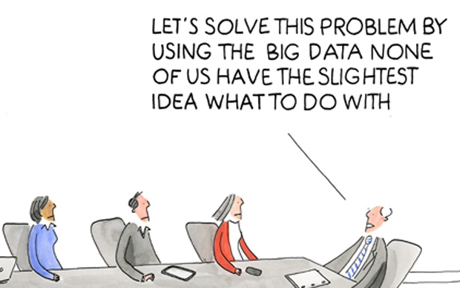
Data, data, and more data
Okay, any volunteers to present what they are working on and where it might lead

Slide 4
Presentations
Laurel Childress
R code for extracting lithologies from DESClogik worksheets
Lithologic naming conventions can be inconsistent and DESClogik has several columns with major, minor, and other lithologic names
Vinny Percuoco
Excel Power BI
Power Query, which is now called Get & Transform
Macros that provide lithologies for track data (WRSML, NGR, etc.) and more
Peter Flaming
Python & Machine Learning applied to borehole data
Maggie Hastedt
Comparison of MAD (discrete sample) and WRMSL (whole round core) densities
Gary Acton
Color of core (see attached slides)

Slide 5
Color of Core Spectrophotometry Applied to Core Photos
18 June 2019

Slide 6
Overview
Extract color info (RGB and L*a*b*) from core photos
Core Photos Used
Photos taken of all core sections while they are on a core photo table
Available from Janus with sufficient resolution
Higher resolution photos can be requested from ODP Databank
Line Scan tiff images (LSIMG)
Resolution Decisions
Medium to ultra high-resolution records
Centimeter to sub-millimeter
Color Space Decision
Initially I focused on just getting L*
Easy to get but image calibration is necessary
Analysis Methods
Calibrating images
Overcoming noise
Paleoenvironmental significance
Examples

Slide 7
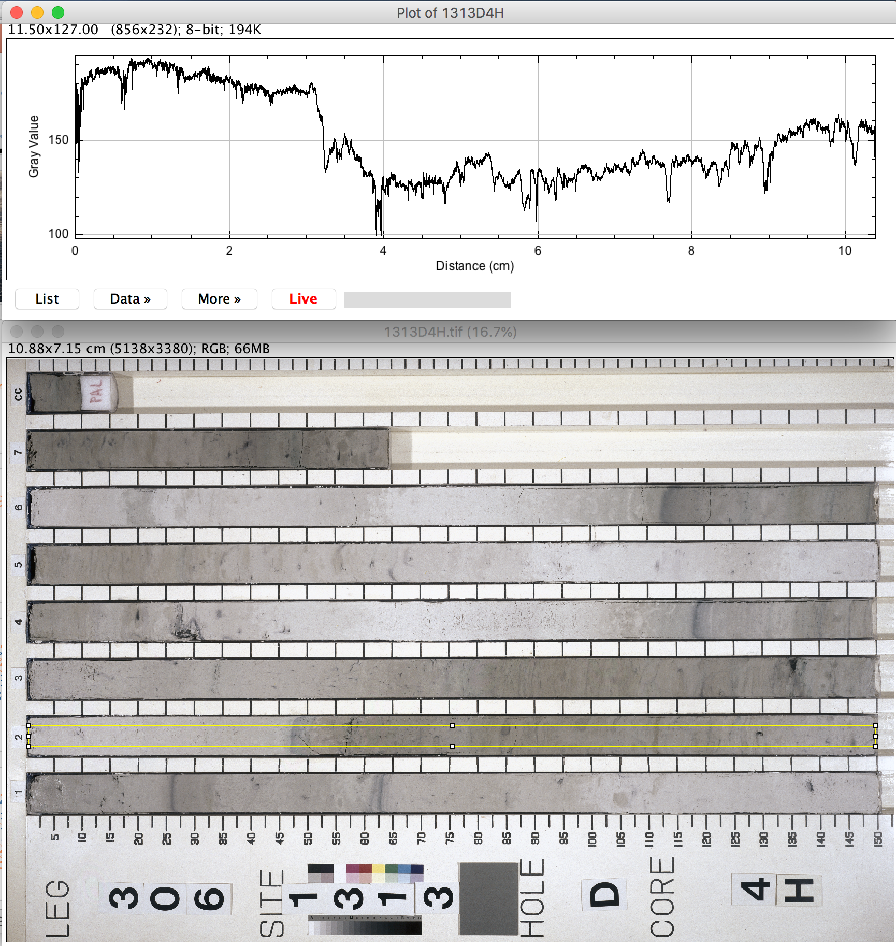
Initial L* Extraction Method
ImageJ
Open core photo & rotate counterclockwise
Make rectangular box over middle of core section and extending from 0 to end of section
Get profile & save data
Scale X to length of section in cm
Resolution ~0.3 mm
Calibrate
Using image’s gray card with correction for variation in light across core photo table
Convert to L*
Or scale to L* from Minolta Color scanner
Clean cracks, blebs, and other non-representative feature
Very manual process

Slide 8
Initial (2008) L* Extraction Method
ImageJ
Open core photo & rotate counterclockwise
Make rectangular box over middle of core section and extending from 0 to end of section
Get profile & save data
Scale X to length of section in cm
Resolution ~0.3 mm
Calibrate
Using image’s gray card with correction for variation in light across core photo table
Convert to L*
Or scale to L* from Minolta Color scanner
Clean cracks, blebs, and other non-representative feature
Very manual process
Example of the 1-mm resolution Lp* data vs. the 2-cm resolution Ls* data for one core section.
We already knew the L* data collected every 2 cm correlated well with the oxygen isotope record.
What might the higher resolution data provide?

Slide 9
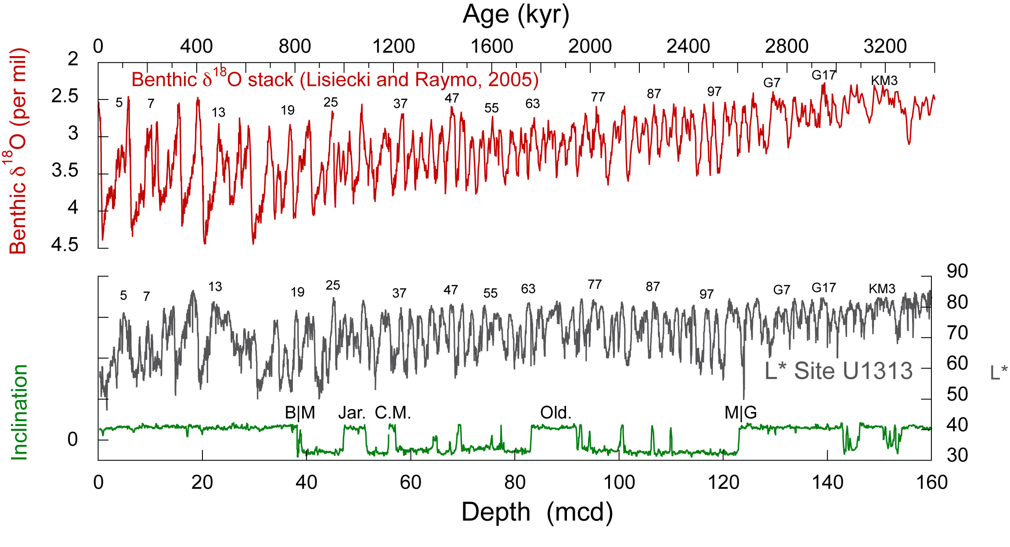
Moderate Resolution Record
Lightness data were obtained with a Minolta Spectrophotometer at 2-cm resolution during Expedition 306 for Site U1313 in the North Atlantic. These data correlate well with the global oxygen isotope stack (LR04).
From Expedition 306 Shipboard Science Party (2005)

Slide 10
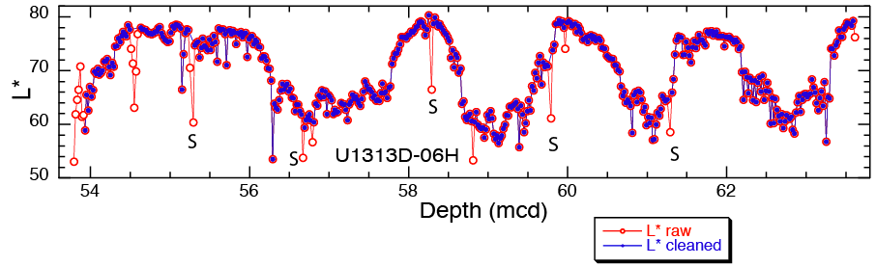
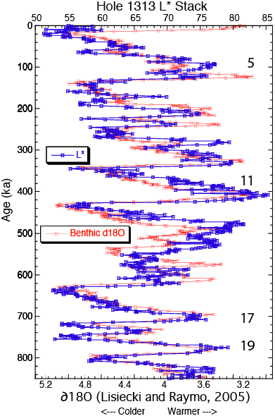
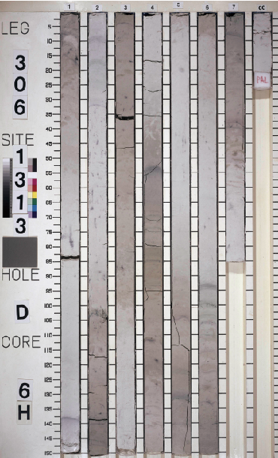
Ls* = Clean Lightness Record with 2-cm resolution ≈ 500 k.y.
MIS 35 37 39 41

Slide 11
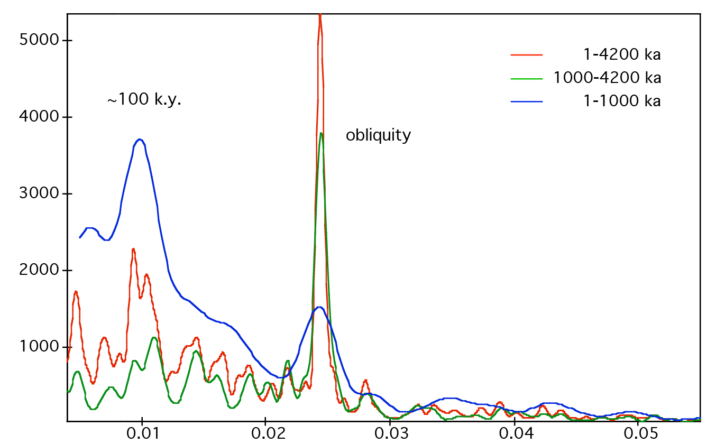
Signal Analysis
Frequency
The most obvious signal is the obliquity in the L* records, with a more subtle 100 k.y. eccentricity peak, which is more dominant after 1 Ma than before. None of this is too surprising given the L* follows the LR04 oxygen isotope record.

Slide 12
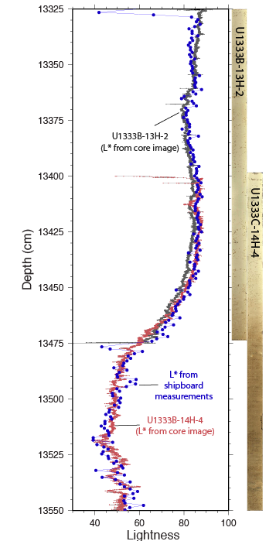
Initial L* Extraction Method
ImageMagick
Estimate gray scale of gray card and used to calibrate image
Extract middle part of image (like slicing out a U-channel)
Convert tiff to text file with RGB values
Use statistics to select best value for each 50 µm interval
Median
Decimate data to desired resolution
Scale to length of section in cm
Resolution 50 µm

Slide 13
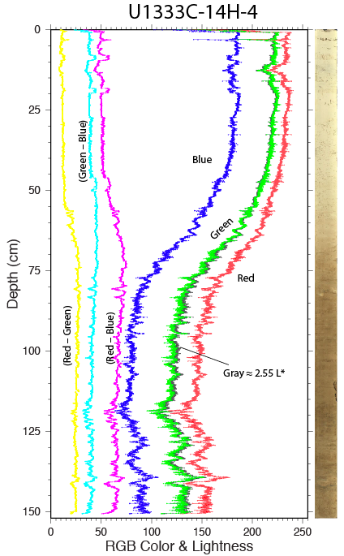
Example Data
Data from Section U1333C-14H-4 across the E-O boundary. The color data are extracted every 0.2 mm from each image, which gives 7500 observations along a typical 150 cm section. We extract the RED, GREEN, and BLUE values from which the GRAY Scale, L*, and other differences and derivative values can be obtained.

Slide 14
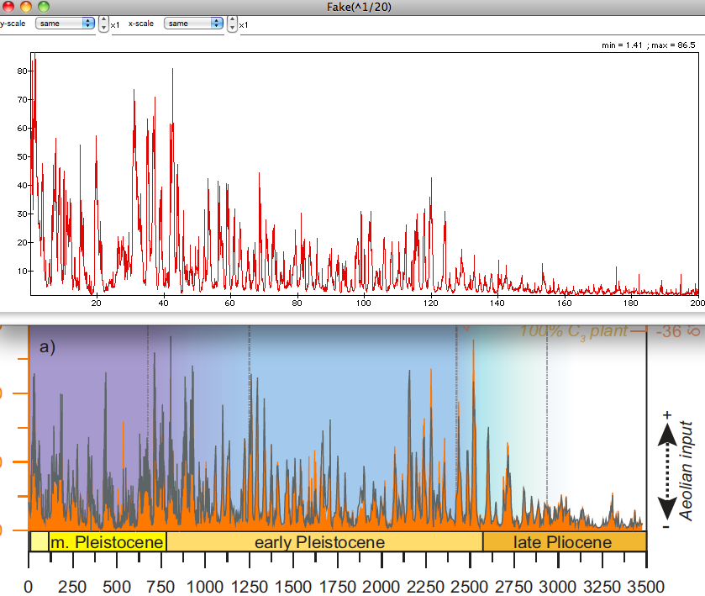
L* vs. Leaf Waxes
The shipboard L* data (in mcd depths) converted using a power law to W (= Wind Proxy) and compared with Naafs et al. (2011) leaf wax abundance. The continuous W record extents out to about 4260 ka, with a longer record possible but correlation between holes degrading.

Slide 15
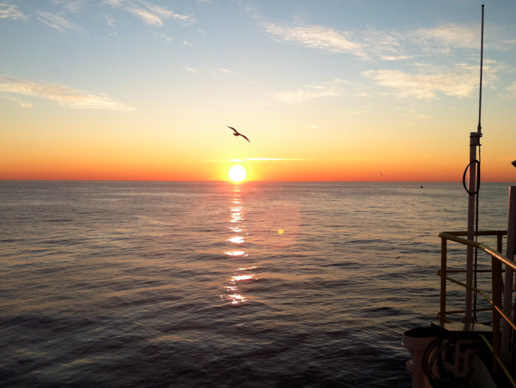
The End

Slide 16
Resolution
Medium, high, and ultra high-resolution records
Observations every
1 cm
Probably good enough from most studies, except finely laminated sediments, like varves
1 mm
Preferred as few laminations are thinner than this and the file size is still manageable
This is also probably close to the image resolution for the core photo images from expeditions prior to Expedition 317 (Core Table Photos)
0.05 mm (50 µm)
The image resolution for the Line Scan imager
Not sure if generating data files with this resolution is worthwhile
The files would be huge

